Slide 1
Approximation Algorithm

Slide 2
Introduction
Approximation algorithms are a class of algorithms designed to find solutions to optimization problems where obtaining an exact solution is computationally infeasible.
These problems are not solvable in polynomial time.
These problems are known as NP hard problems.
These problems are significantly effective to solve real world problems.

Slide 3
Introduction
Use of heuristics may help to solve a large instance of problem quickly. We have seen backtracking and branch-and-bound.
A heuristic, however, does not work equally effectively on all problem instances. Depending on input, they may take exponential time.
Instead of finding an optimal solution, we will try to find a solution that is closer to optimal solution.

Slide 4
Introduction
A feasible solution with value close to the value of an optimal solution is called an approximate solution.
An approximation algorithm for P is an algorithm that generates approximate solutions for P.

Slide 5
Traveling Salesman Problem
The travelling salesman problem is a graph computational problem where the salesman needs to visit all cities (represented using nodes in a graph) in a list just once.
The distances (represented using edges in the graph) between all these cities are known.
The solution that is needed to be found for this problem is the shortest possible route in which the salesman visits all the cities and returns to the origin city.

Slide 6
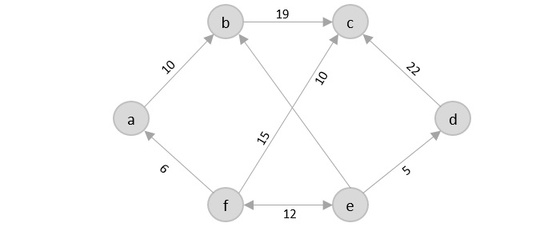
Traveling Salesman Problem
If you look at the graph below, considering that the salesman starts from the vertex a, they need to travel through all the remaining vertices b, c, d, e, f and get back to a while making sure that the cost taken is minimum.

Slide 7
Traveling Salesman Problem
There is no polynomial time solution available for this problem as the problem is a known NP-Hard problem
There are approximate algorithms to solve the problem though.
The approximate algorithms work only if the problem instance satisfies Triangle-Inequality.

Slide 8
Triangle Inequality
The least distant path to reach a vertex j from i is always to reach j directly from i, rather than through some other vertex k (or vertices).
For any three cities A, B, and C, the triangle inequality says:
d(A,C)≤d(A,B)+d(B,C)
Going directly from A → C should never be more expensive than going indirectly through another city (A → B → C).

Slide 9
Approximation Algorithm for TSP
The travelling salesperson approximation algorithm requires some prerequisite algorithms to be performed so we can achieve a near optimal solution.
Minimum Spanning Tree − The minimum spanning tree is a tree data structure that contains all the vertices of main graph with minimum number of edges connecting them. We apply prims algorithm for minimum spanning tree in this case.
Pre-order Traversal − The pre-order traversal is done on tree data structures where a pointer is walked through all the nodes of the tree in a [root left child right child] order.

Slide 10
Algorithm
Step 1 − Choose any vertex of the given graph randomly as the starting and ending point.
Step 2 − Construct a minimum spanning tree of the graph with the vertex chosen as the root using prims algorithm.
Step 3 − Once the spanning tree is constructed, pre-order traversal is performed on the minimum spanning tree obtained in the previous step.
Step 4 − The pre-order solution obtained is the Hamiltonian path of the travelling salesperson.

Slide 11
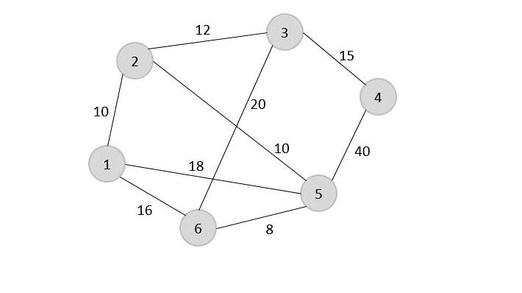
TSP-Example

Slide 12
Solution
Consider vertex 1 from the above graph as the starting and ending point of the travelling salesperson and begin the algorithm from here.
Step 1 − Starting the algorithm from vertex 1, construct a minimum spanning tree from the graph.

Slide 13
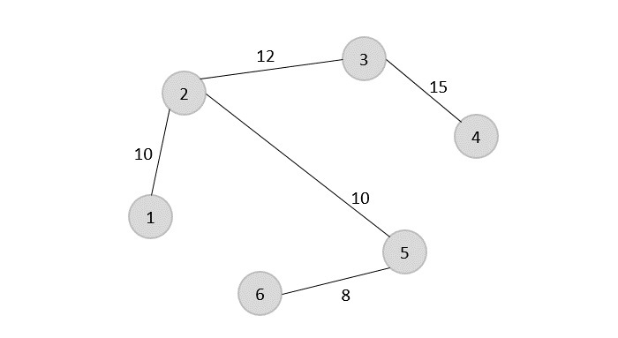
Solution
Step 1 − Starting the algorithm from vertex 1, construct a minimum spanning tree from the graph.

Slide 14
Solution
Step 2 − Once, the minimum spanning tree is constructed, consider the starting vertex as the root node (i.e., vertex 1) and walk through the spanning tree preorderly.

Slide 15
Solution
The preorder traversal of the tree is found to be − 1 → 2 → 3 → 4 → 5 → 6
Step 3
Adding the root node at the end of the traced path, we get, 1 → 2 → 3 → 4
→ 5 → 6 → 1 and total cost is 10+12+15+40+8+16=101
40
16

Slide 16
How is this algorithm 2-approximate
2-approximate: The cost of the output produced by the algorithm is never more than twice the cost of best possible output.
The cost of best possible Travelling Salesman tour is never less than the cost of MST. (The definition of MST says, it is a minimum cost tree that connects all vertices).
The total cost of full walk is at most twice the cost of MST (Every edge of MST is visited at-most twice)

Slide 17
References
https://www.tutorialspoint.com/data_structures_algorithms/travelling_salesman_problem.html
https://www.geeksforgeeks.org/dsa/approximate-solution-for-travelling-salesman-problem-using-mst/
Computer Algorithms
– Ellis Horowitz, Sartaj Sahni, Sanguthevar Rajasekaran.

Slide 18
Thank You

